Slide 1
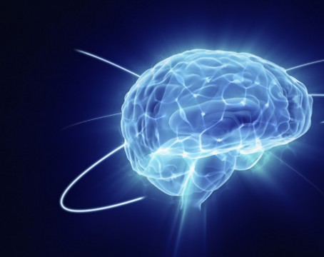
ANALYSIS OF BRAINWAVES BEHAVIOUR DURING MEDITATION
Rebecca Estiarte
Data Analysis 2020
Ironhack Barcelona

Slide 2

WHAT IS MINDFULNESS?
Sati: consciousness, attention to the present moment
Meditation is a form of training the mind to reach a state of Mindfulness

Slide 3
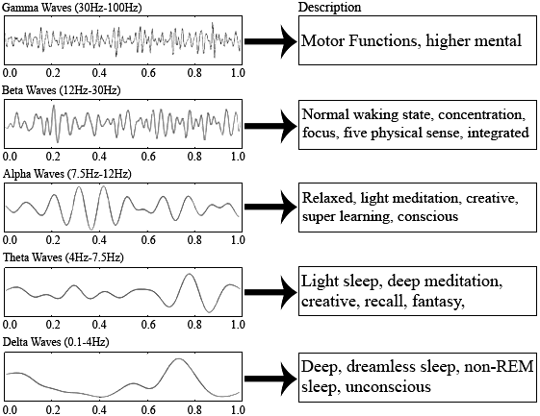
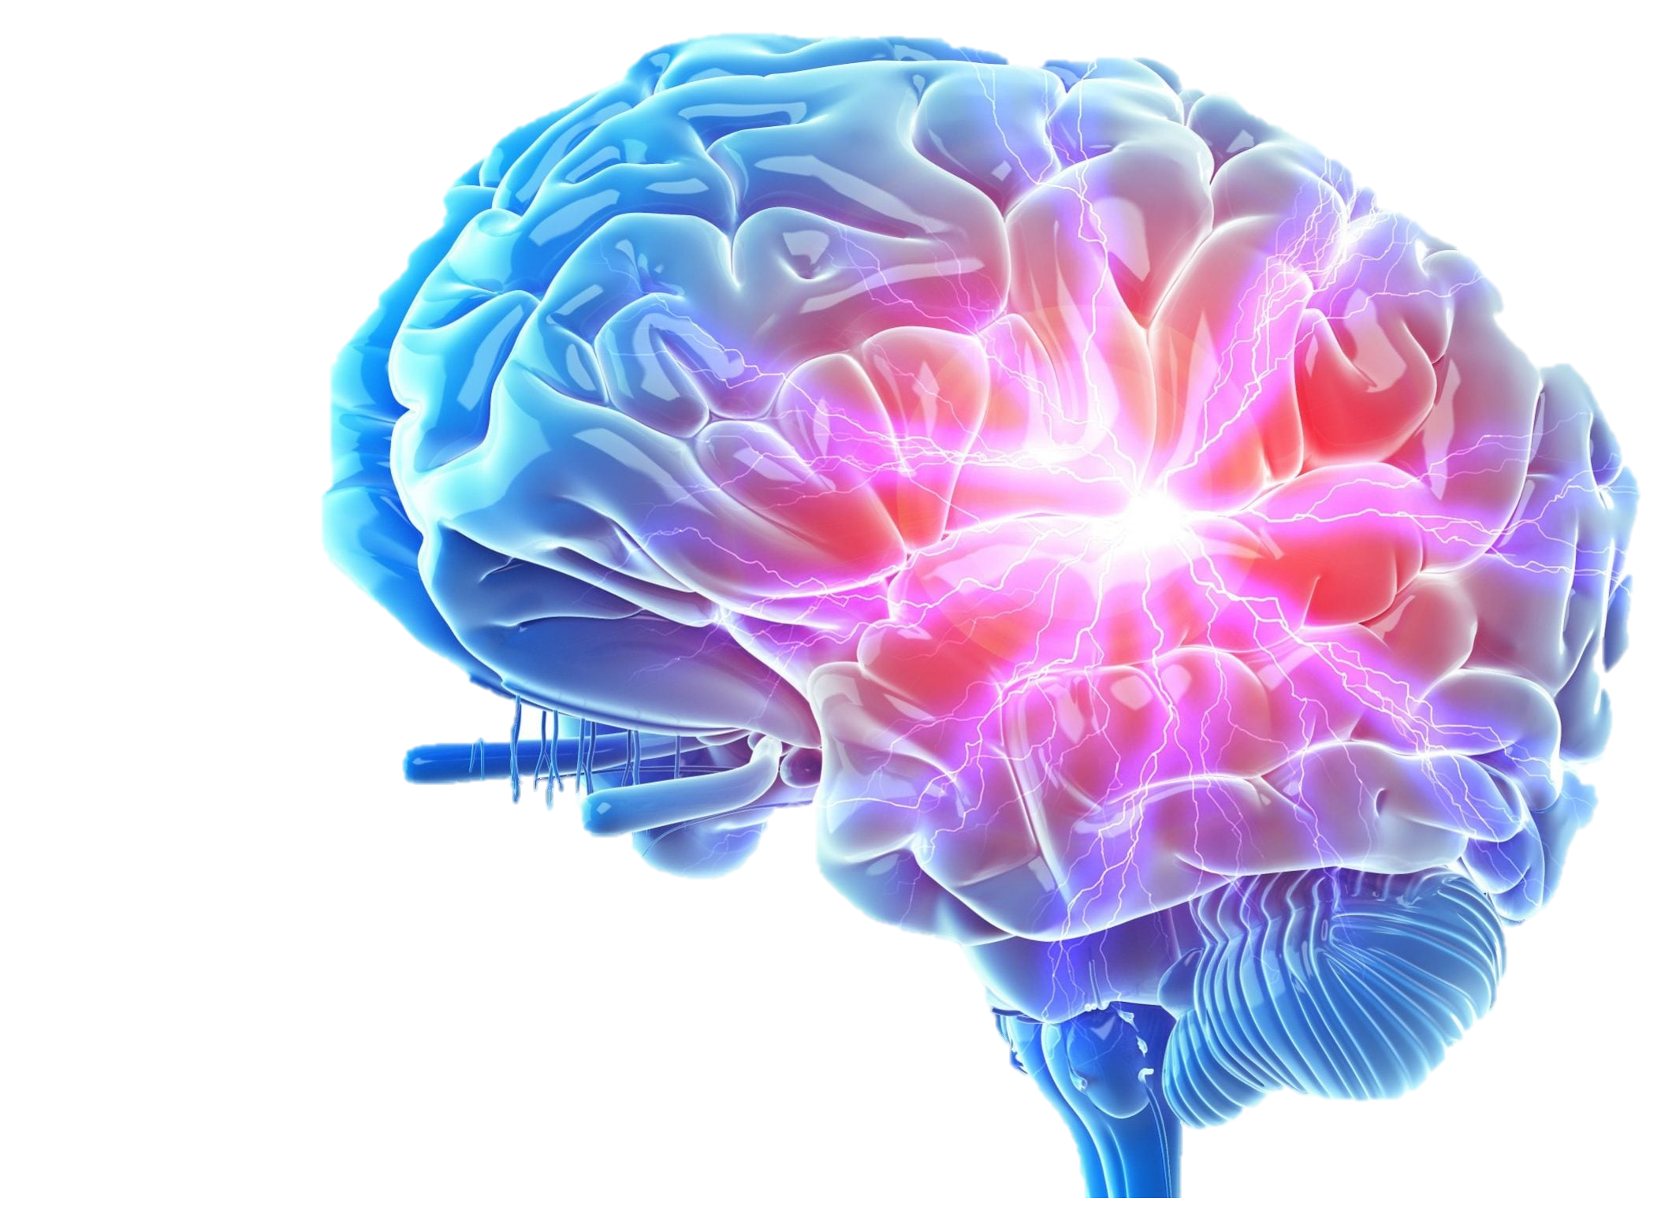
HOW DOES IT AFFECT OUR BRAIN?

Slide 4


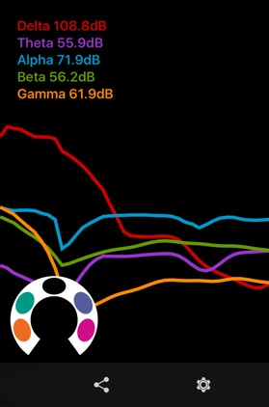
THE EXPERIMENT

Slide 5
THE RESULTS

Slide 6
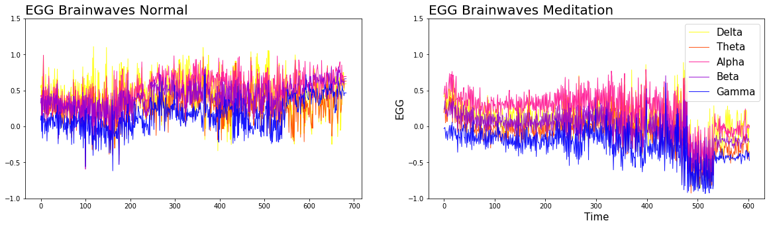
AGGREGATE BRAINWAVES BEHAVIOUR
O1: BRAINWAVES MOVE CLOSER TO OPTIMAL RANGE IN MEDITATION
CONROL
O2: ALPHA WAVES ARE PREDOMINANT IN MEDITATION
MEDITATION
O3: GAMMA WAVES HAVE MORE PEAKS IN MEDITATION

Slide 7
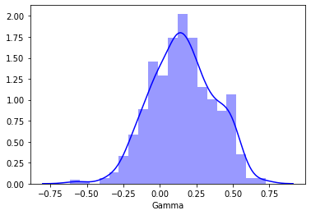
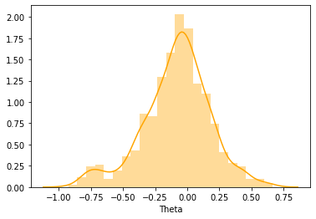
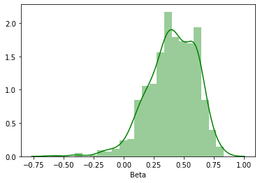
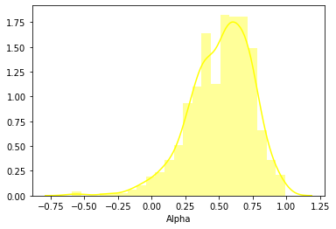
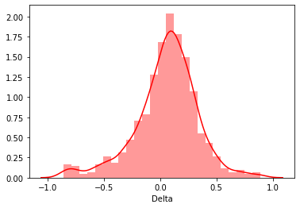
PROVING NORMALITY OF DISTRIBUTION IN BRAINWAVES

Slide 8
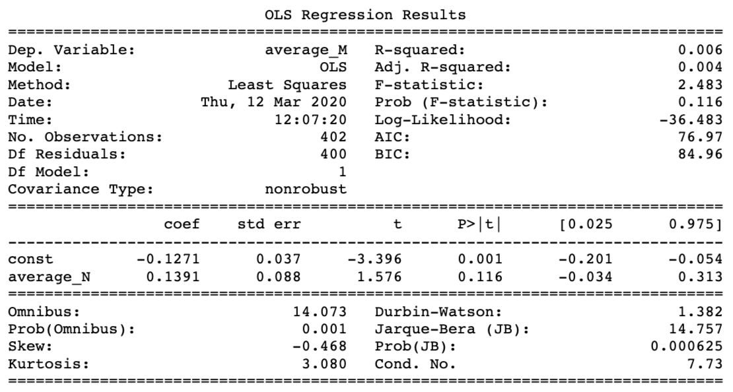
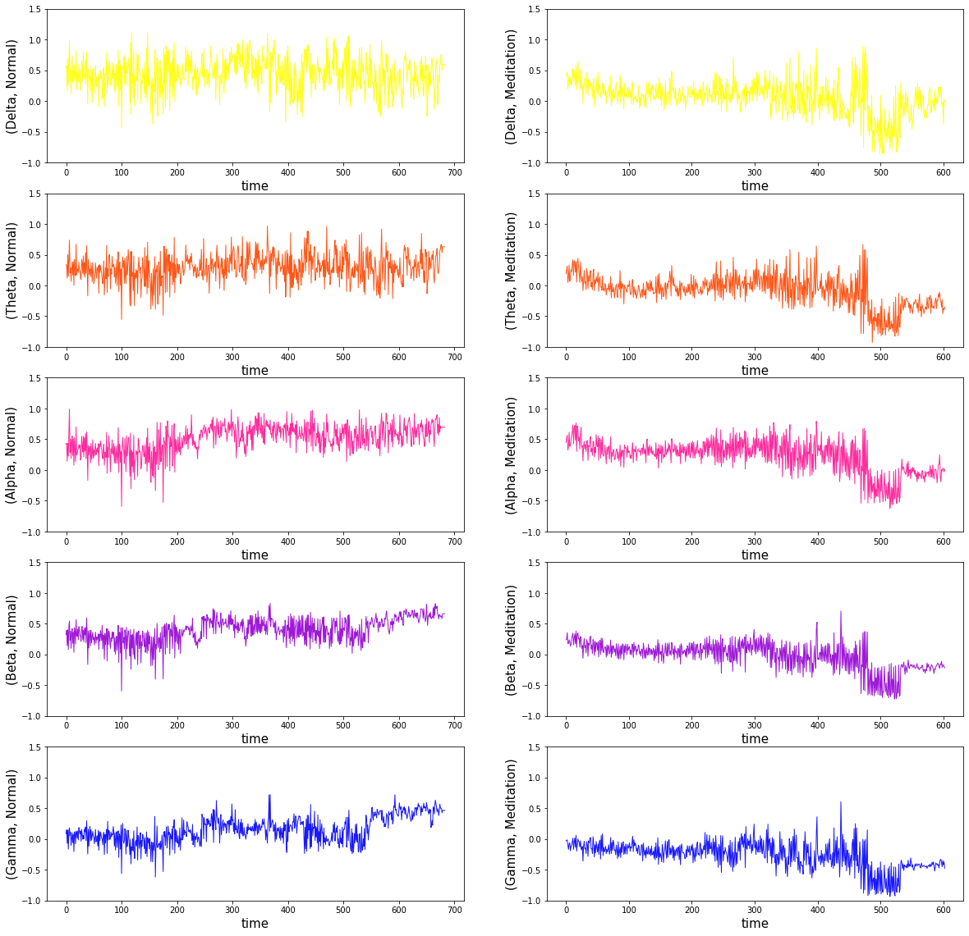
H1: THE AVERAGE BRAIN FREQUENCIES AT MEDITATIVE STATE ARE CLOSER TO OPTIMAL RANGE (-/+ 0,5 )
CONTROL
MEDITATION
Control avg. : 0.39
Meditation avg.: -0.072
Normal average < meditation average

Slide 9
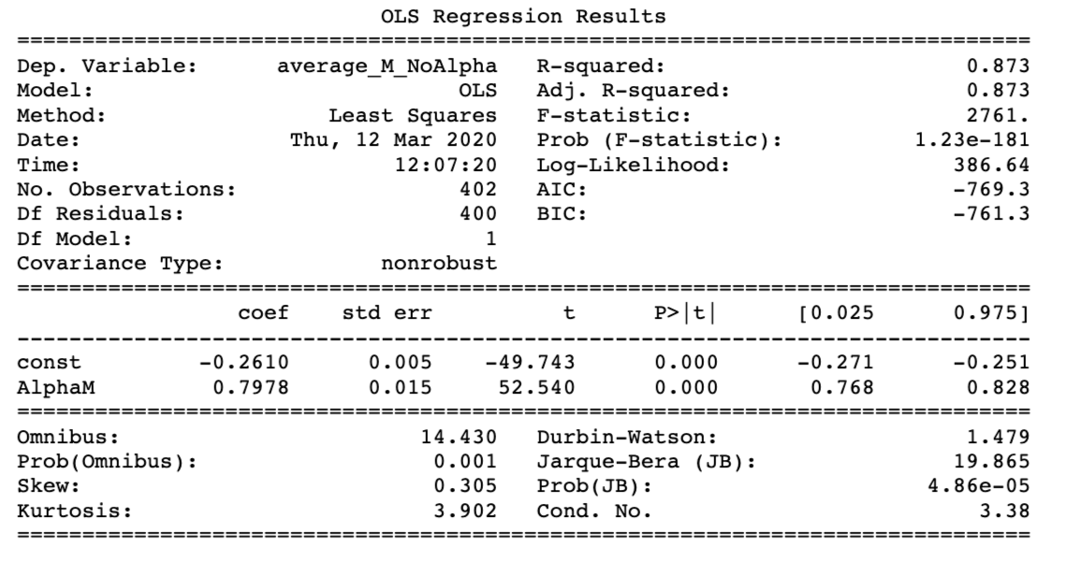
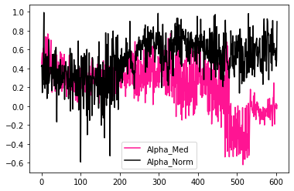
H2: THE AVERAGE ALPHA WAVES FREQUENCIES ARE PREDOMINANT DURING MEDITATION)
Alpha avg. Meditation: 0.17
Other avg. Meditation: -0.13
Alpha_frequencies_med > Other_frequencies_med

Slide 10
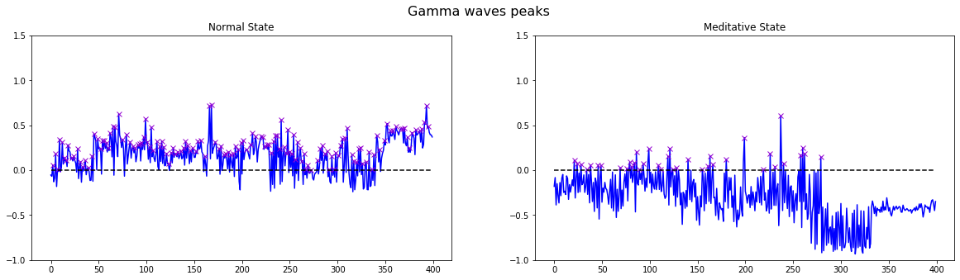
H3: GAMMA WAVES HAVE MORE PEAKS IN MEDITATION
Peaks at Normal are: 27
Peaks at Meditation are: 38

Slide 11
THE CONCLUSIONS
O1: BRAINWAVES MOVE CLOSER TO OPTIMAL RANGE IN MEDITATION
O2: ALPHA WAVES ARE PREDOMINANT IN MEDITATION
O3: GAMMA WAVES HAVE MORE PEAKS IN MEDITATION

Slide 12





NAMASTE BEAUTIFUL SOULS!

